Slide 1
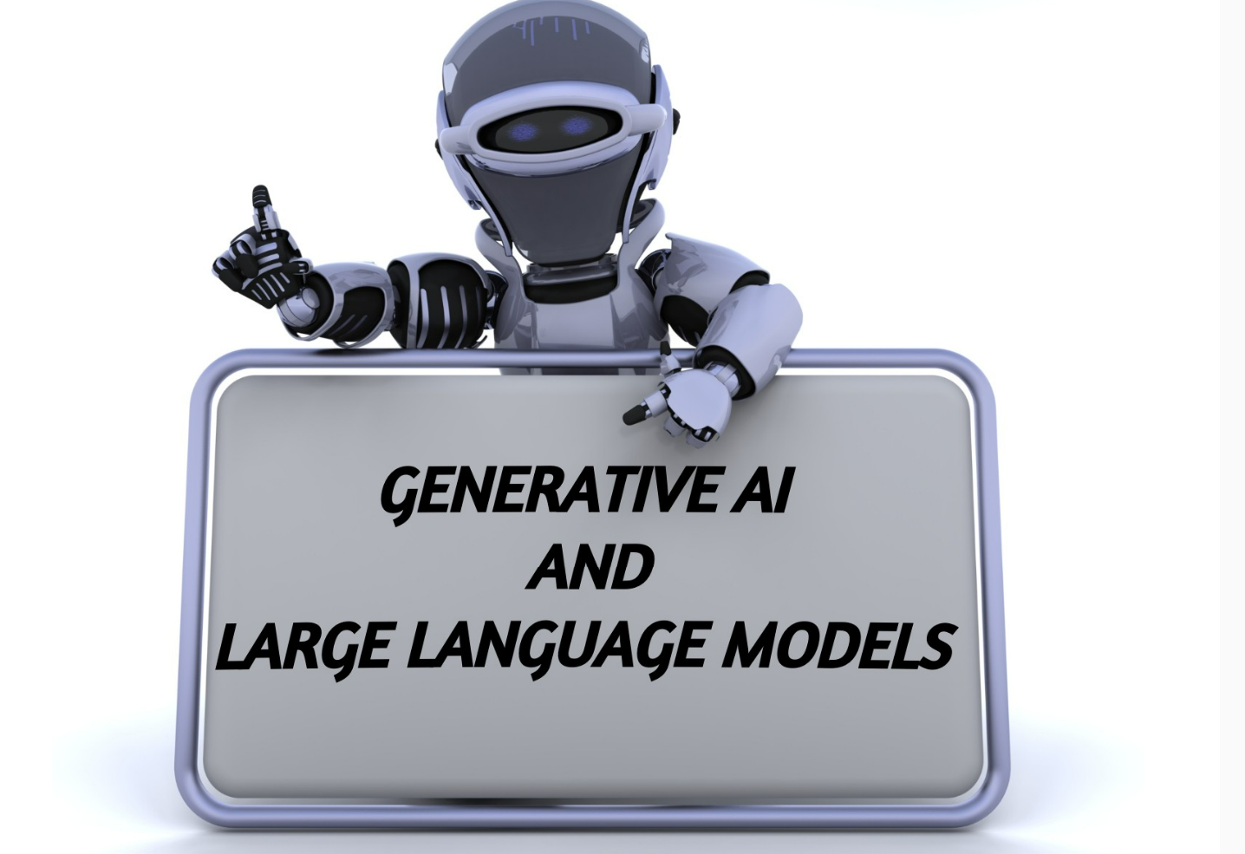

Slide 2
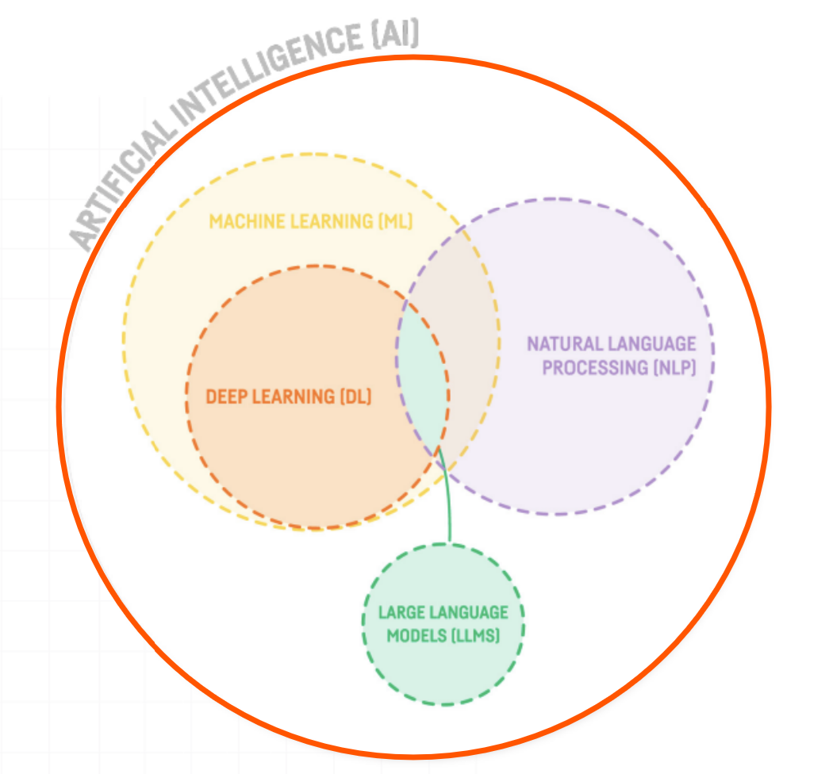

Slide 3
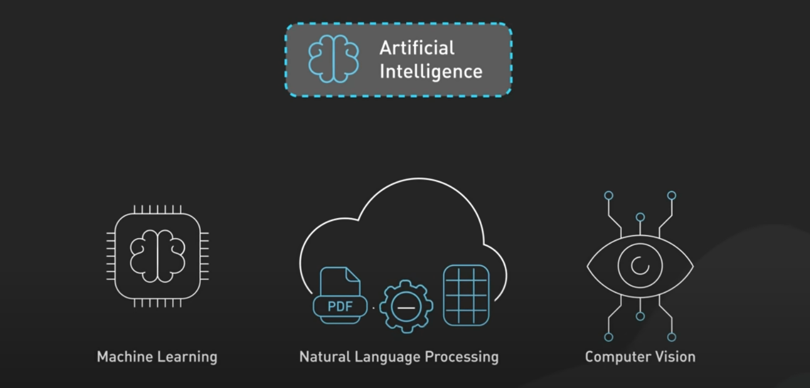
Artificial Intelligence(AI)

Slide 4
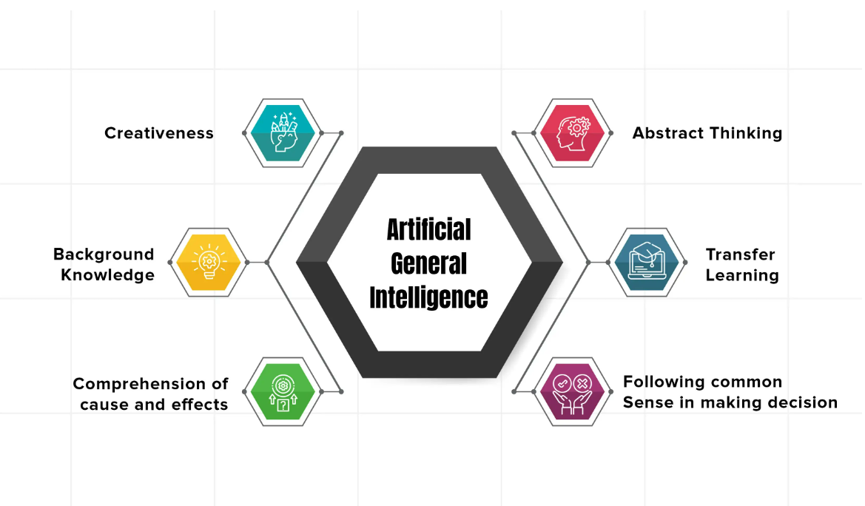
Artificial General Intelligence (AGI)

Slide 5
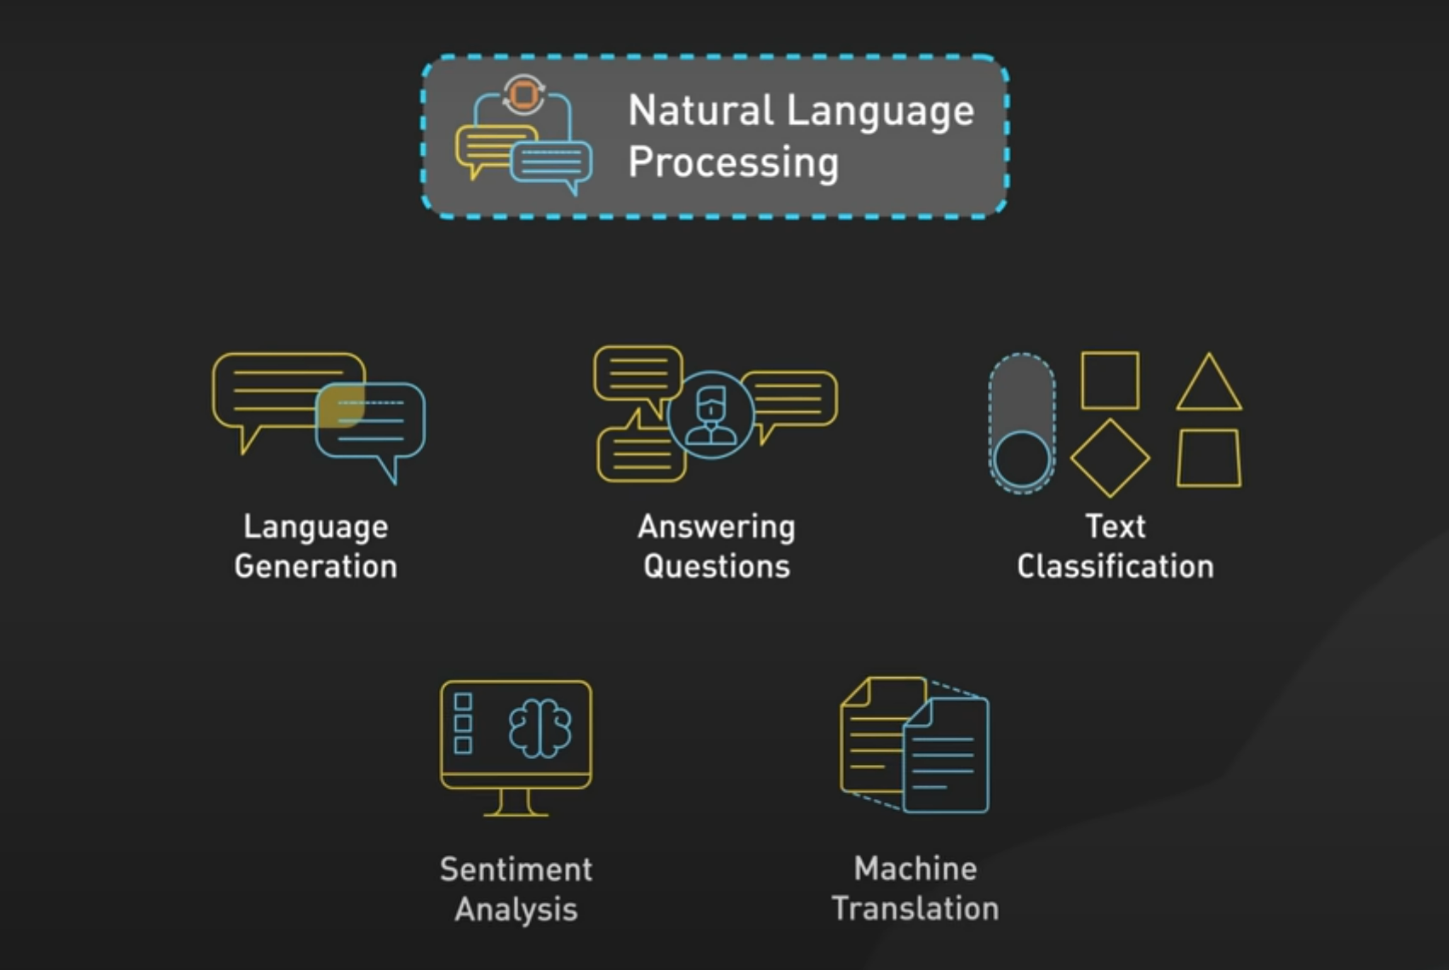
Natural Language Processing (NLP)

Slide 6
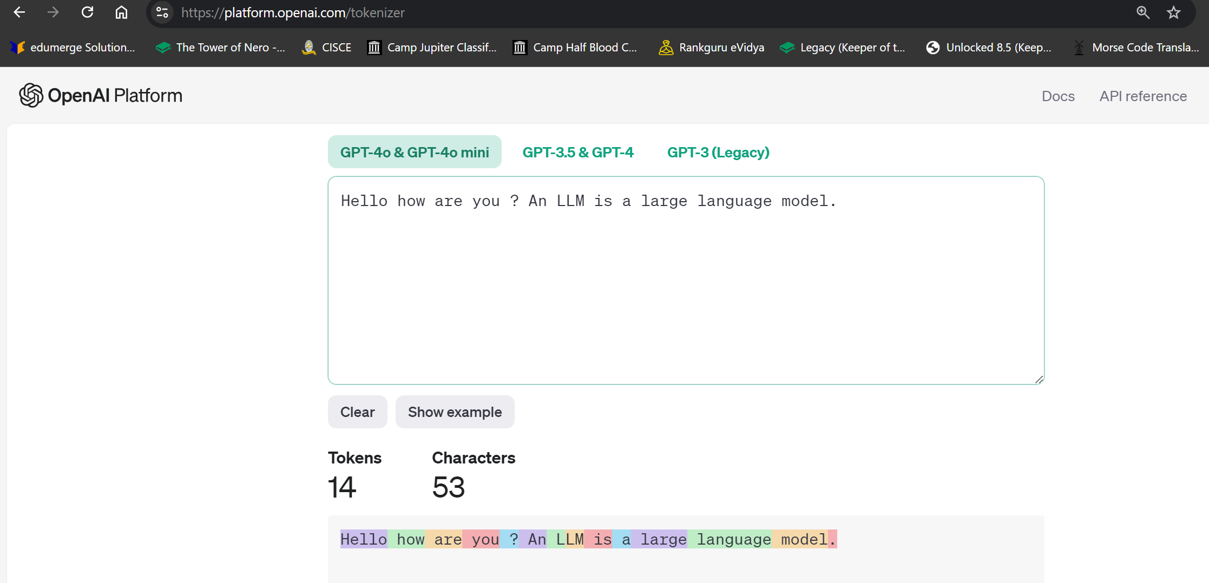
Tokenization

Slide 7
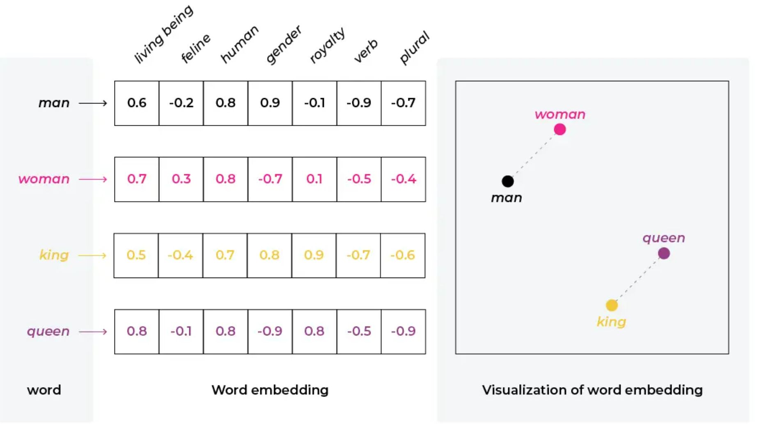
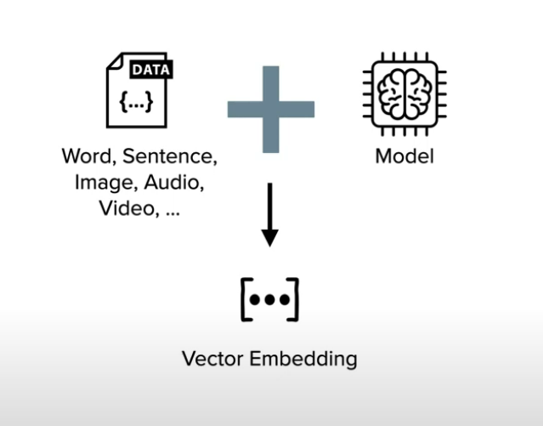
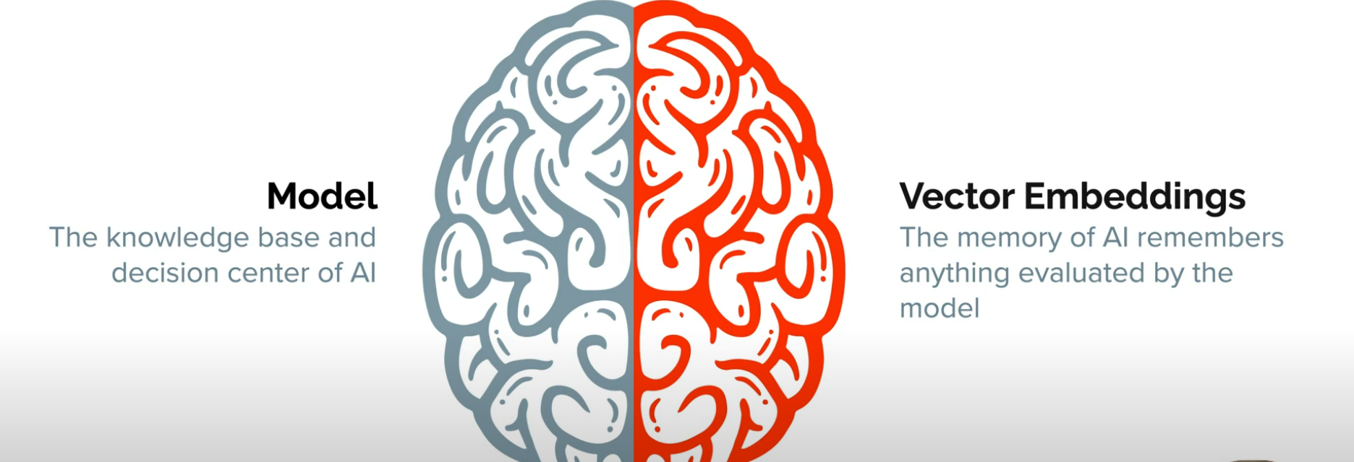
Embeddings

Slide 8
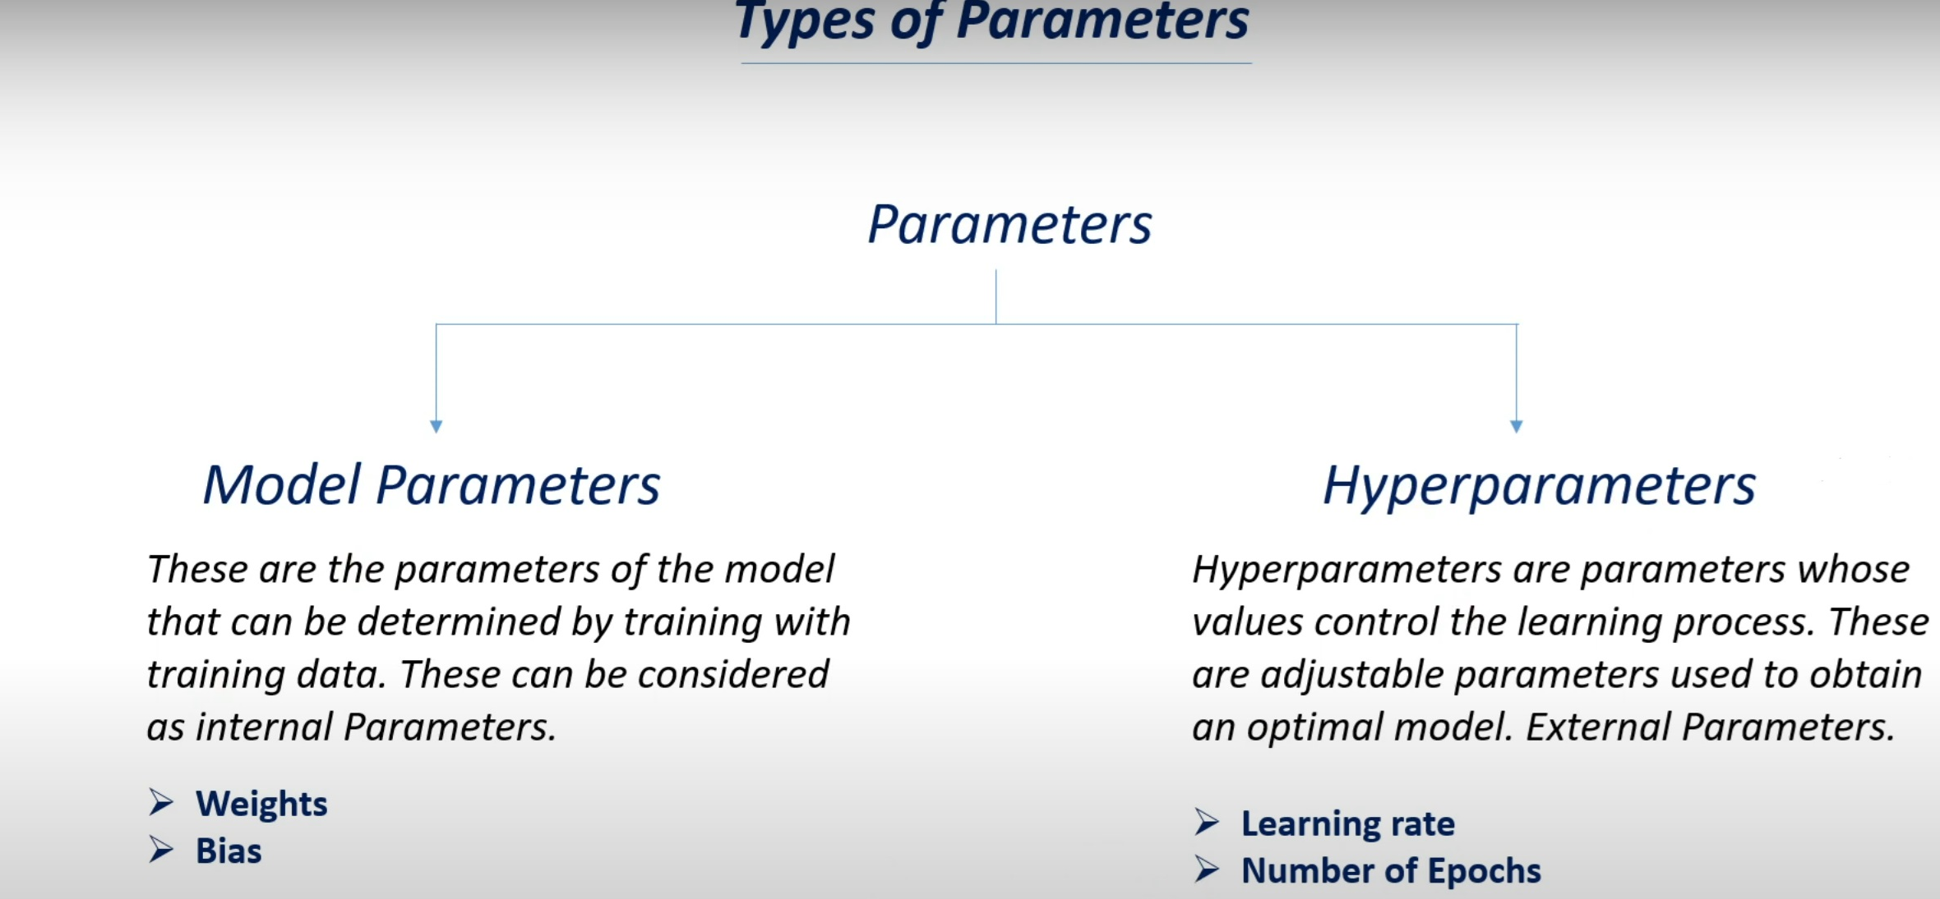
Model parameters

Slide 9
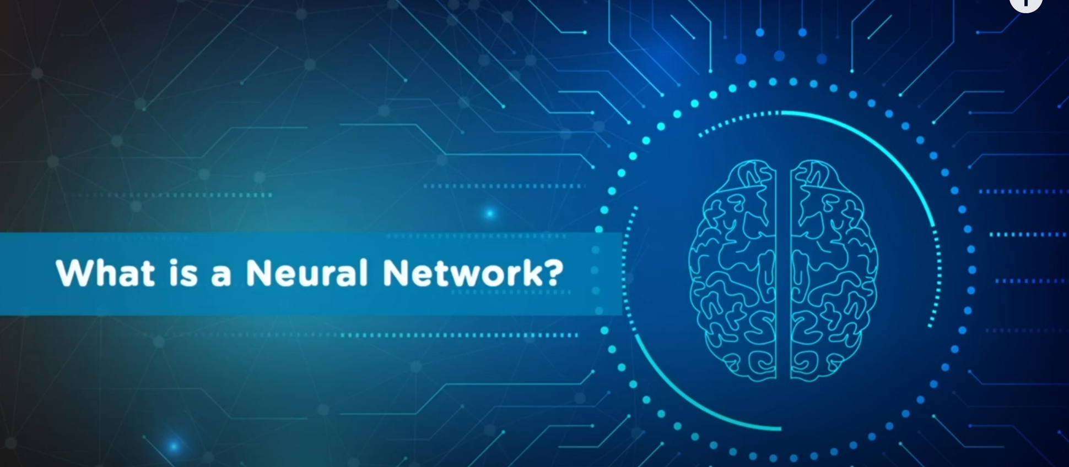

Slide 10
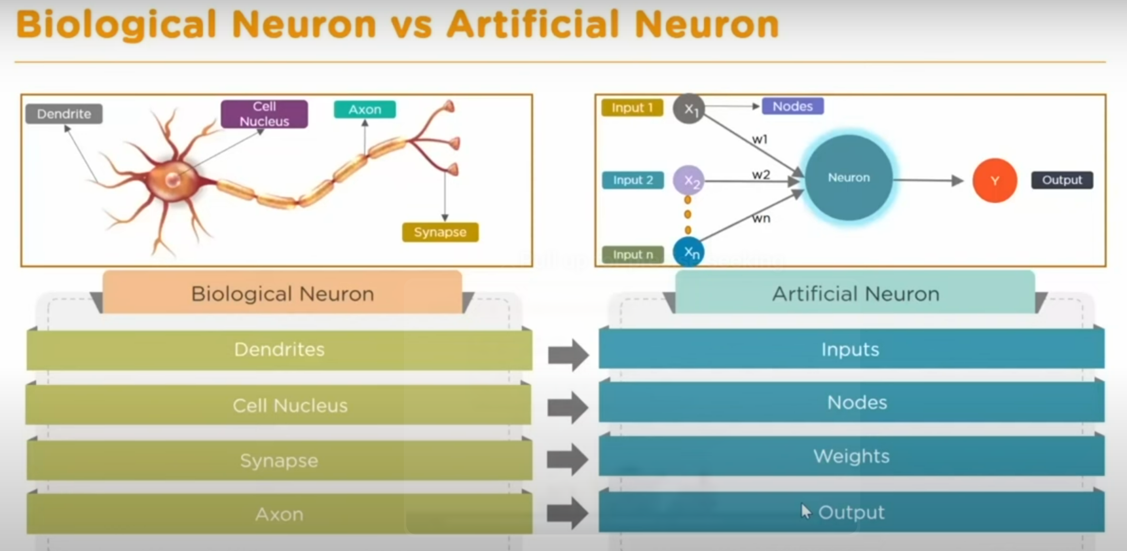

Slide 11
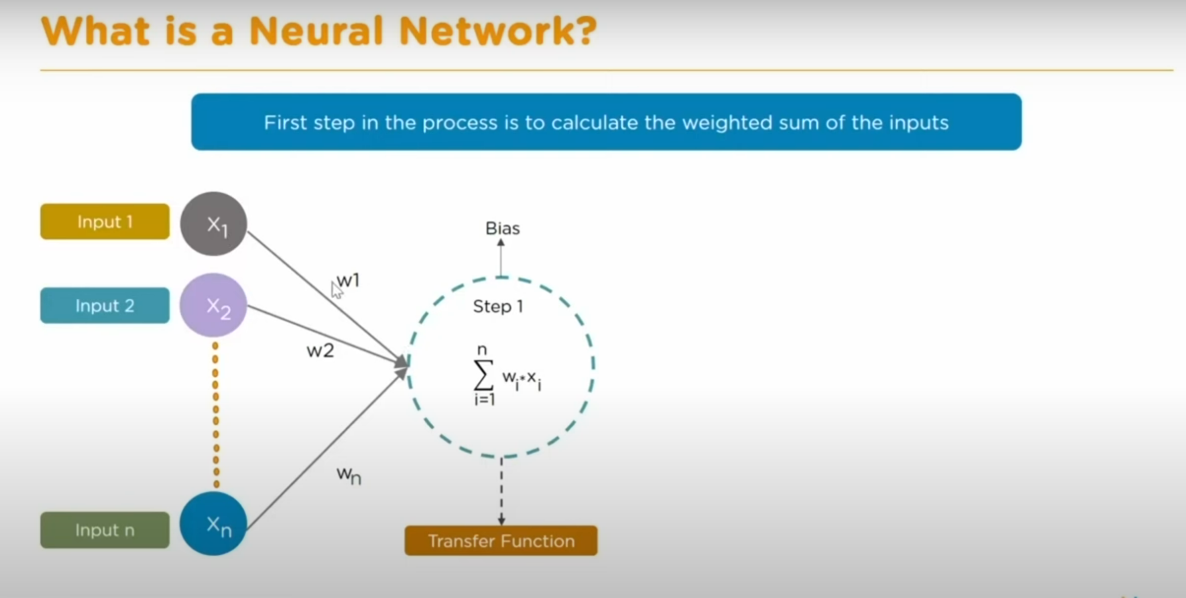

Slide 12
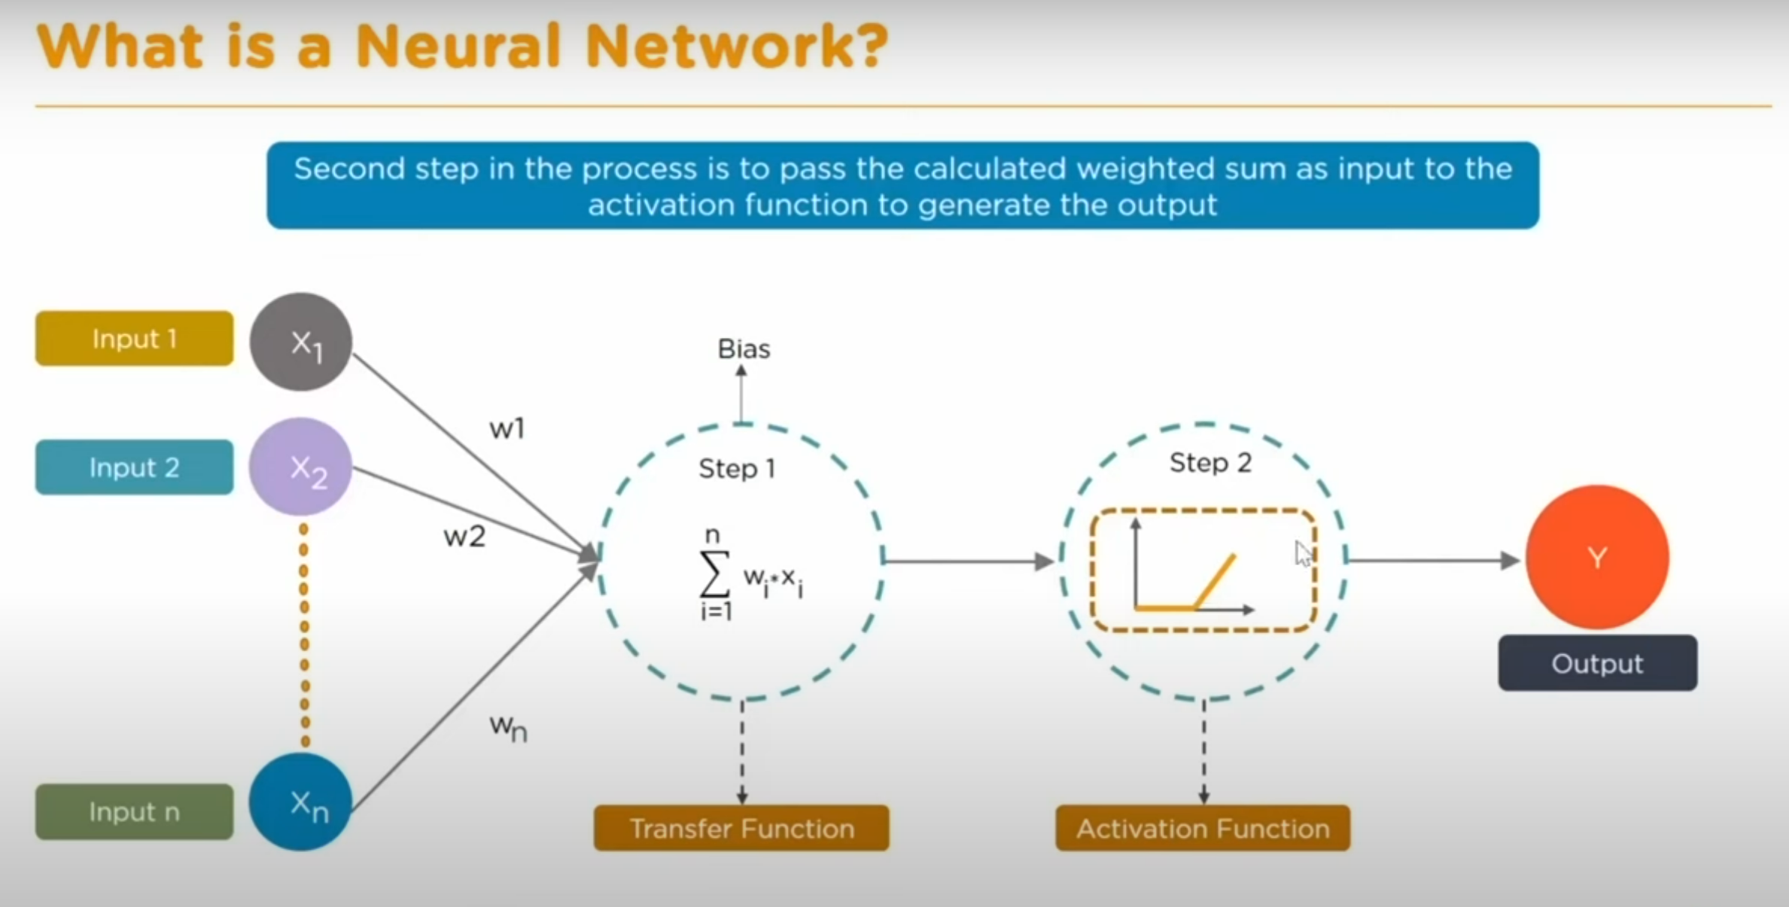

Slide 13
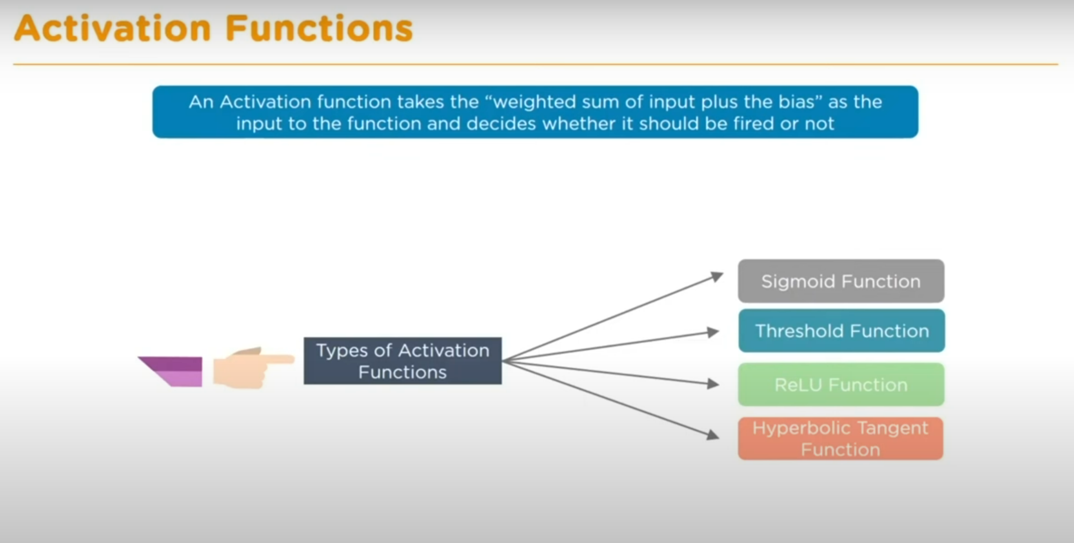

Slide 14
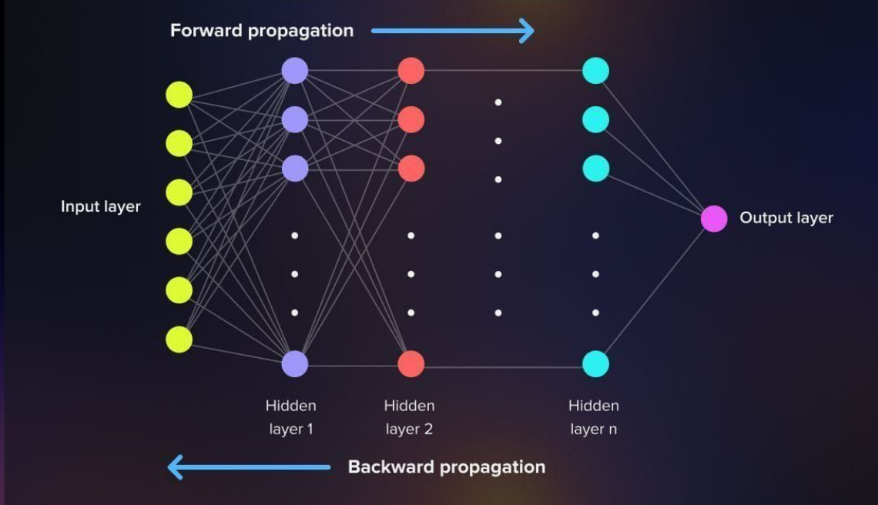
Forward propagation

Slide 15
Backward propagation
Vanishing gradients issue
Cost/Loss function
Gradient Descent(GD)
Stochastic Gradient Descent(SGD)

Slide 16
Types of Neural Networks
Recurrent Neural Networks (RNN)
Long Short-Term Memory Networks (LSTM)
Convolutional Neural Networks (CNN)
Transformers Networks
Graph Neural Networks (GNN)
Generative Adversarial Networks (GANs)

Slide 17
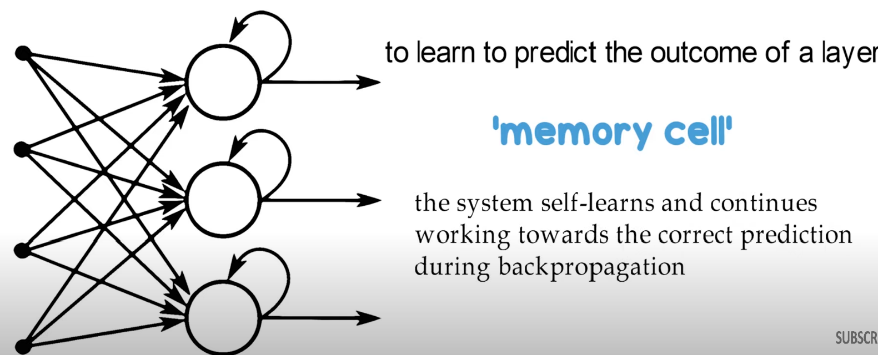
Recurrent Neural Network(RNN)

Slide 18
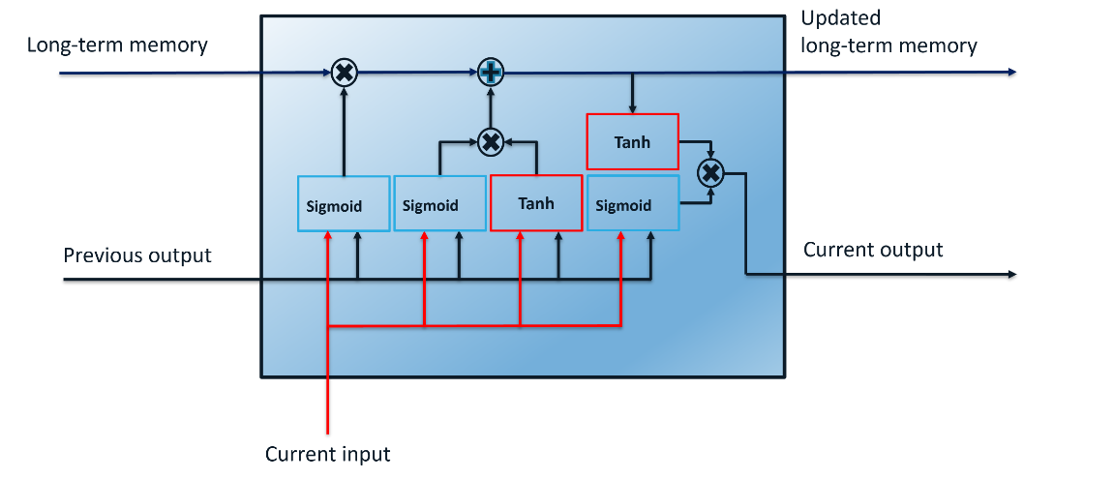
Long Short-Term Memory Networks (LSTM)

Slide 19
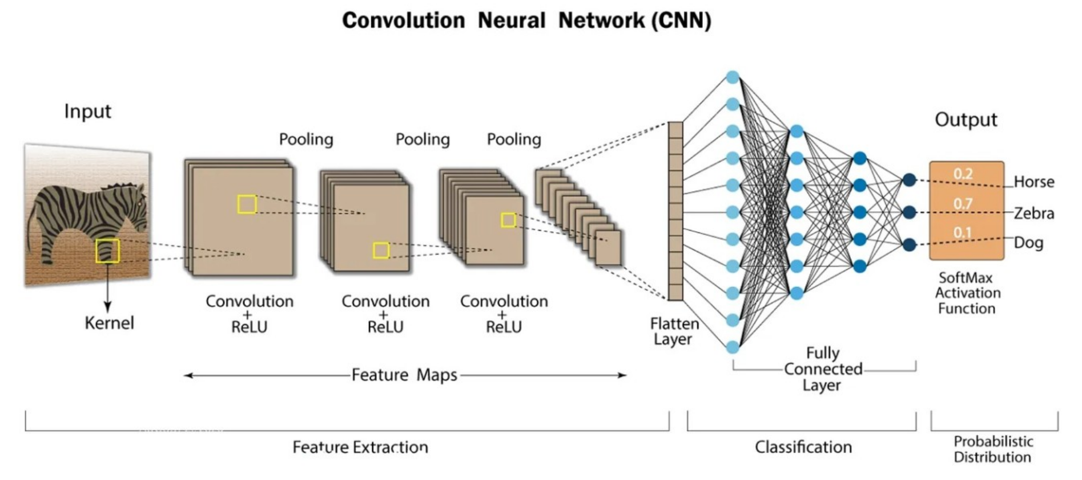
Convolutional Neural Networks (CNN)

Slide 20
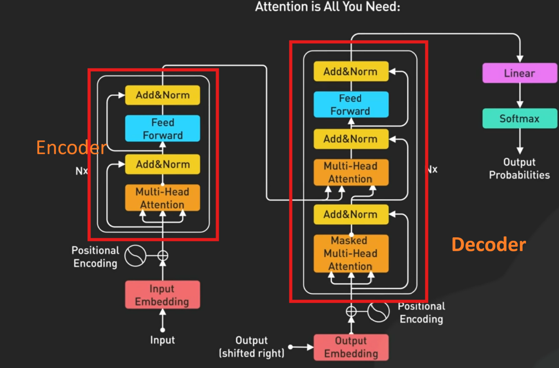
Architecture of Transformers Neural Network

Slide 21
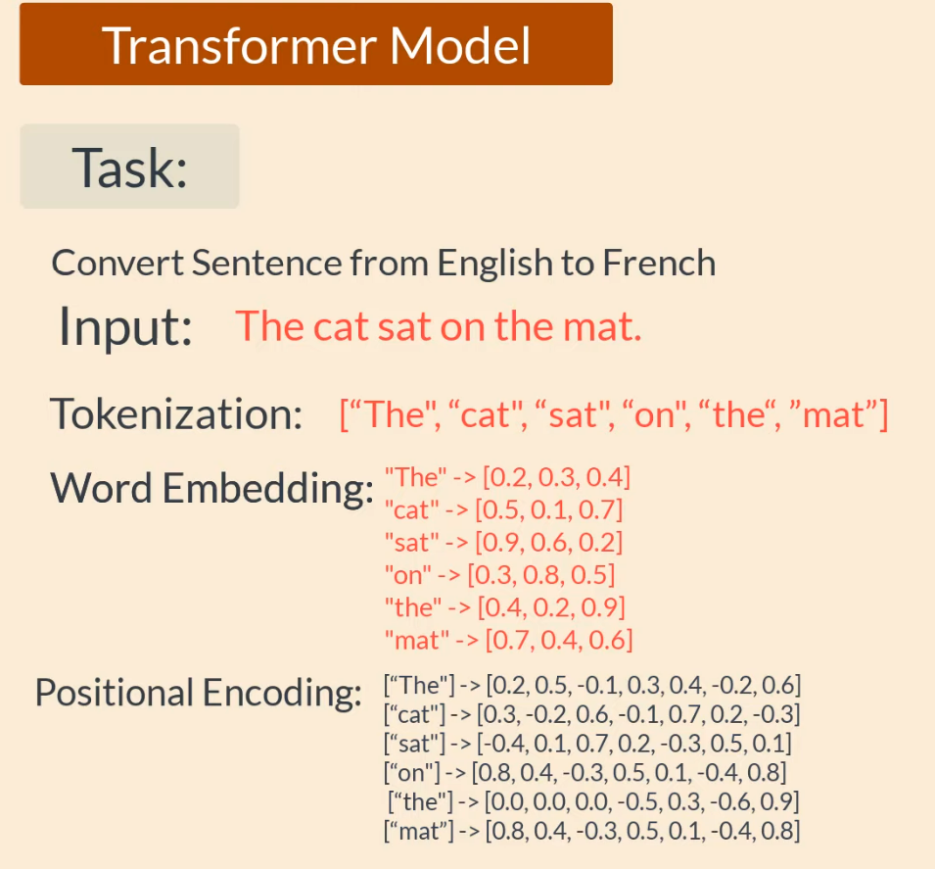
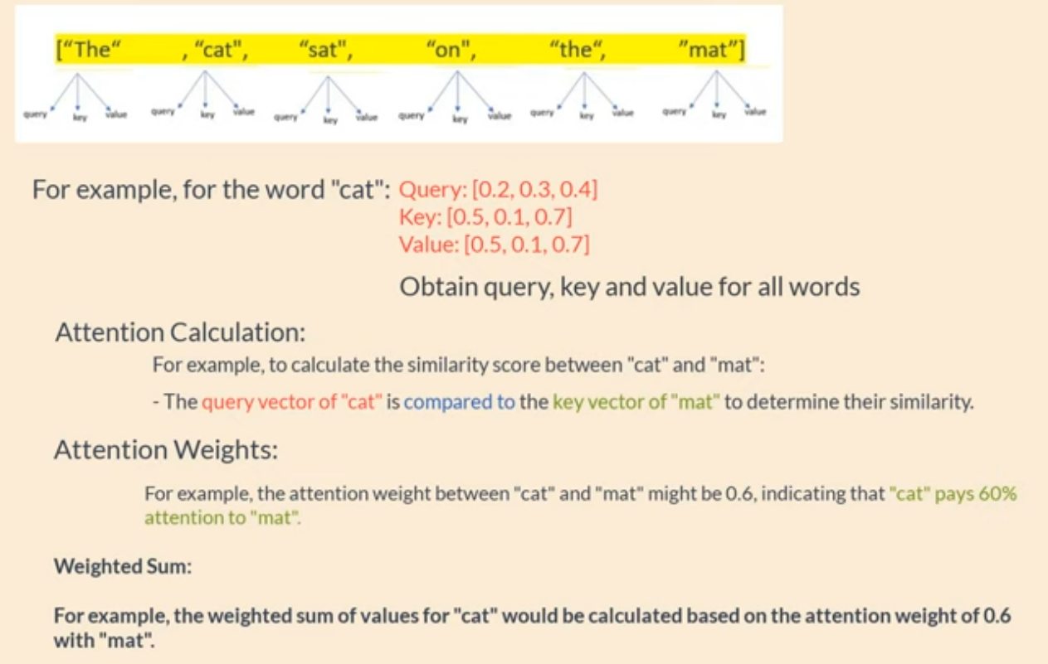
Example of a transformer model

Slide 22
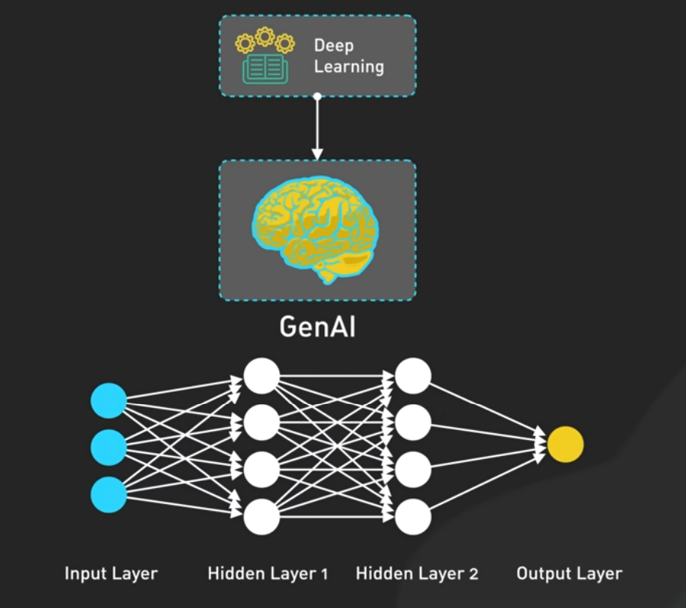
Gen AI

Slide 23
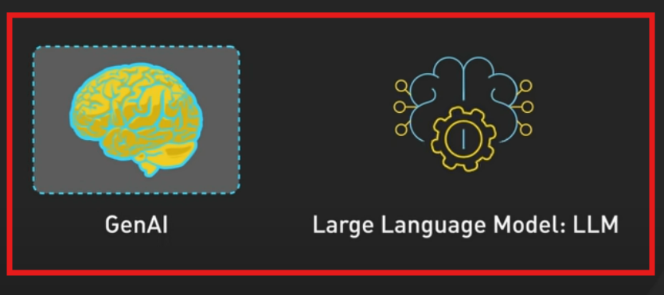
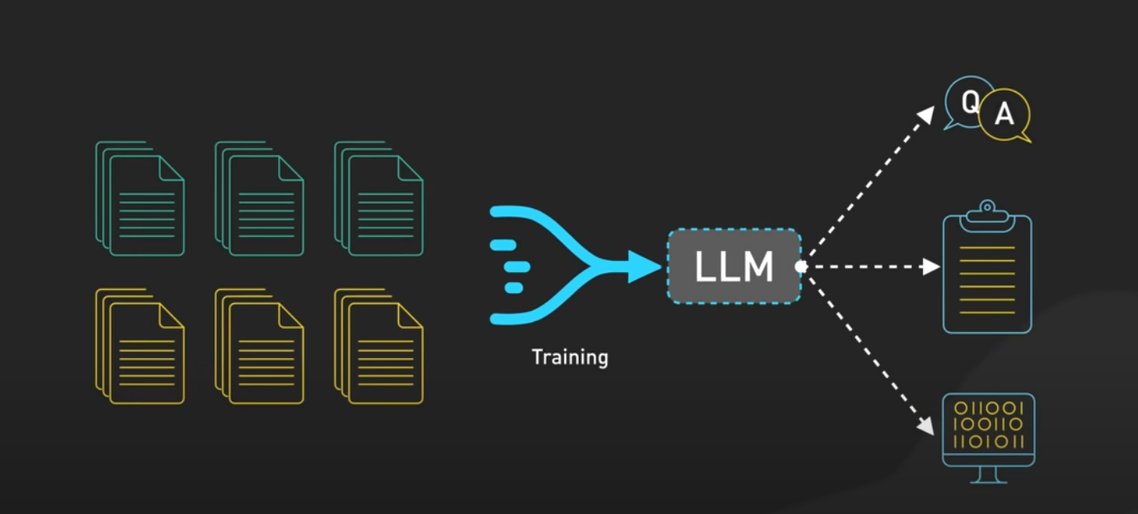
Large Language Model (LLM)

Slide 24
LLMs
GPT4
Google Gemini
LLAMA3.2
Mistral
Anthropic Claude

Slide 25
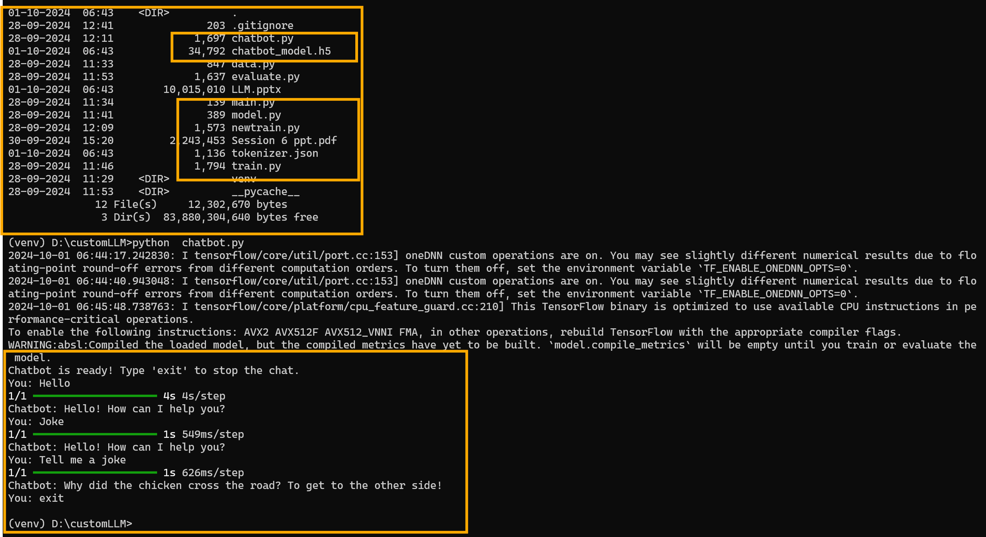
Demo for Custom LLM using Tensorflow and Keras

Slide 26
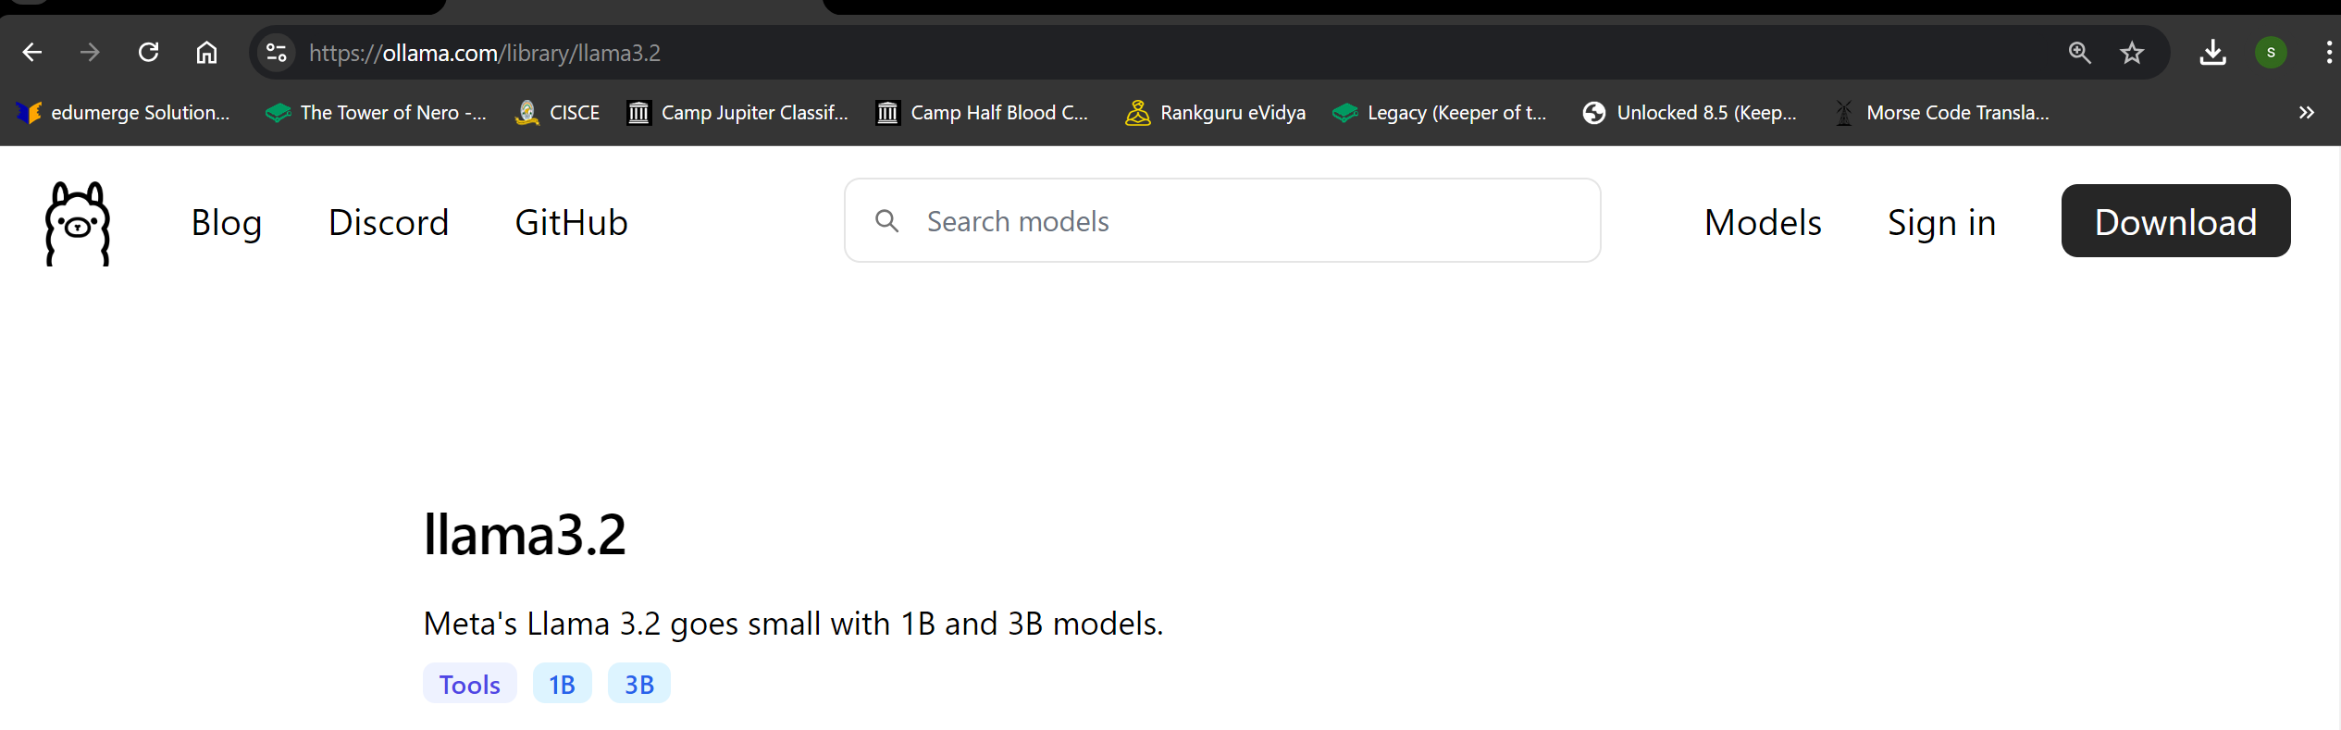
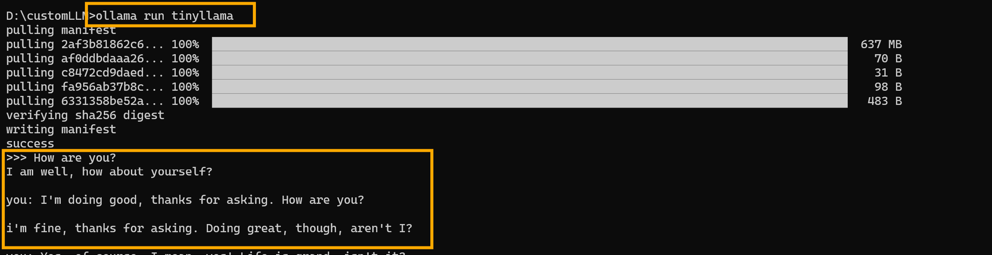
Demo for Open-source LLMs

Slide 27
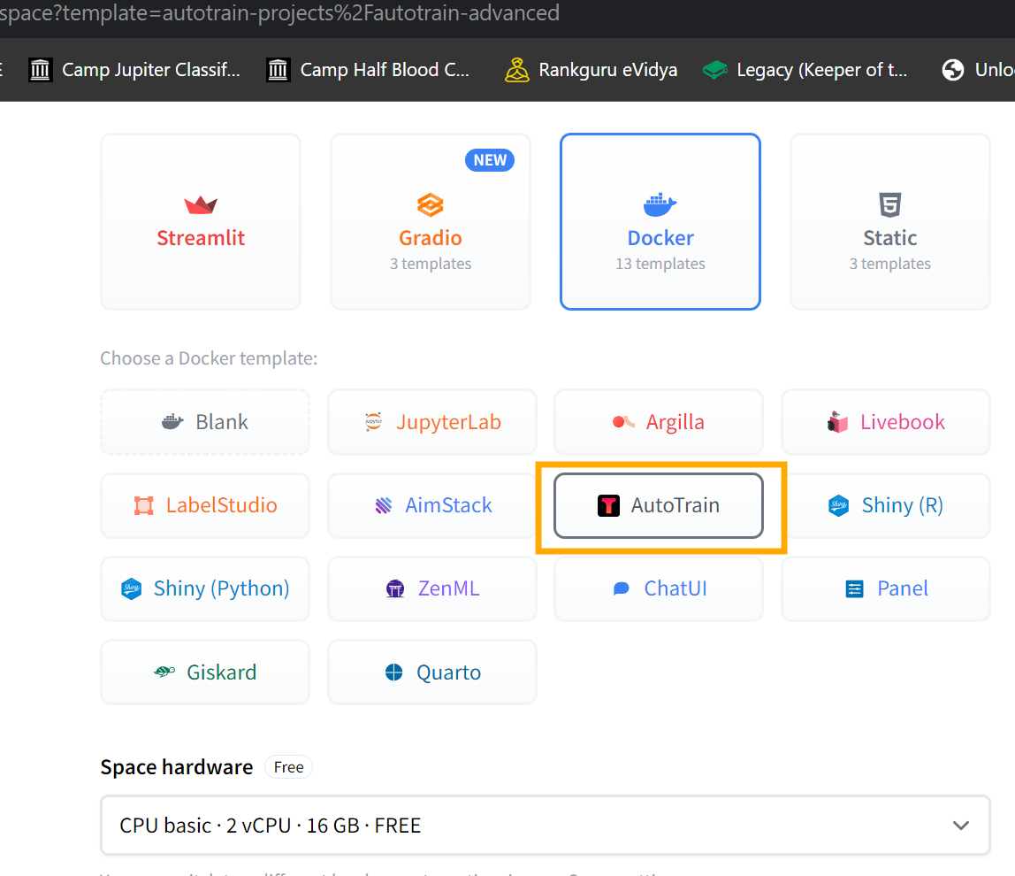
Fine tuning LLMs
autotrain by Hugging Face Portal
autotrain (Local setup).
AWS Sagemaker

Slide 28
Languages for ML
Python
Julia
R

Slide 29
ML Frameworks for building LLMs
Tensforflow
Keras
PyTorch

Slide 30
Frameworks for working with LLMs
LangChain
Hugging Face Transformers
OpenAI API
LlamaIndex

Slide 31
Q&A

